Slide 1
Overview of C
Programming Language

Slide 2
int main(void)
{
  C programs contain one or more functions, exactly one of which must be function main
  Parenthesis () used to indicate a function
  int means that main "returns" an integer value (status code) to operating system when it terminates.
  void means that the main function receives no data from the operating system when it starts executing.
  Left brace { indicates start of a block (of code)
    The “bodies” of all functions must be contained in braces -
    the body of a function is a block of code
    Here it is the body of the function main

Slide 3
printf( “Hello World!\n" );
  Instructs computer to perform an action
    Specifically, print the string of characters within quotes (“ ”)
    Makes use of standard I/O function, printf
  Entire line called a statement
    All statements must end with a semicolon (;)
  Escape character (\)
    Indicates that printf should do something out of the ordinary
    \n is the newline character

Slide 4
return (0);
}
  A way to exit a function
  return (0) means that the program terminated normally
  Right brace } indicates end of a block (of code)
    Here indicates end of main function has been reached

Slide 5
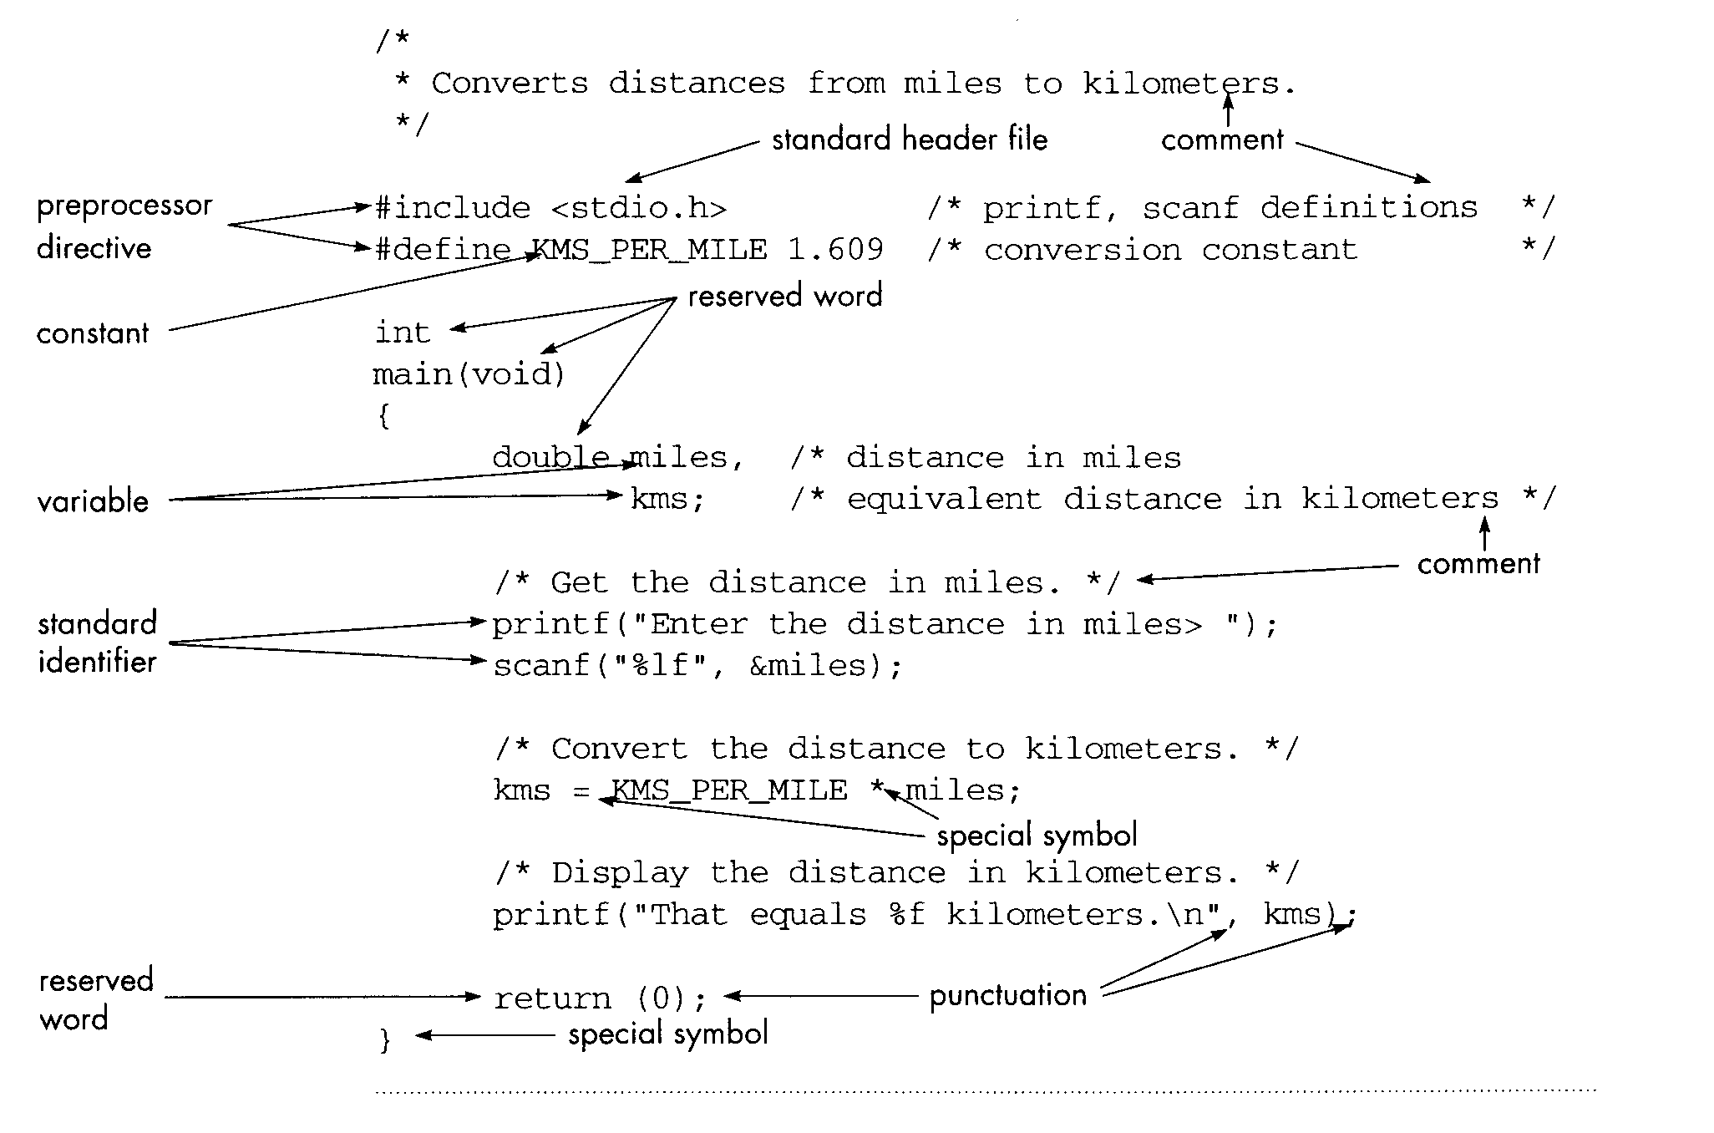
Consider a C program for the miles-to-kilometers problem.

Slide 6
Different kinds of statements in a C program
Preprocessor directives
#include <stdio.h>
Include the source code for library file stdio.h. Enables C
compiler to recognize printf and scanf from this library.
#define KMS_PER_MILE 1.609
Defines a constant. The value 1.609 is associated with the
name KMS_PER_MILE everywhere in the program.
Preprocessor substitutes value 1.609 for the name KMS_PER_MILE wherever it appears in program.

Slide 7
As a result, the code statement
kms = KMS_PER_MILE * miles;
would be modified by the preprocessor to become
kms = 1.609 * miles;

Slide 8
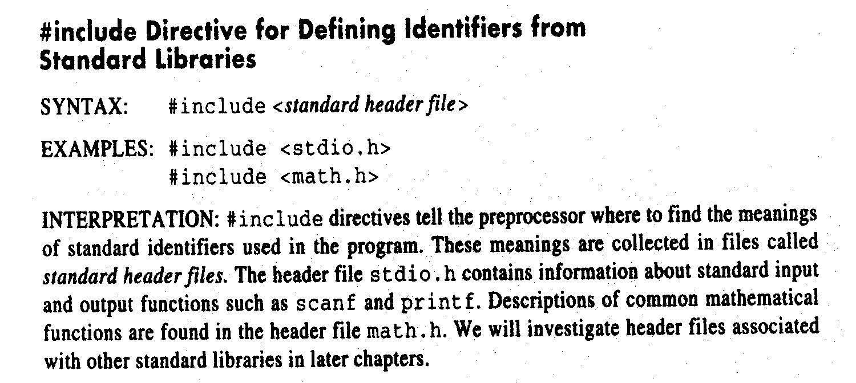
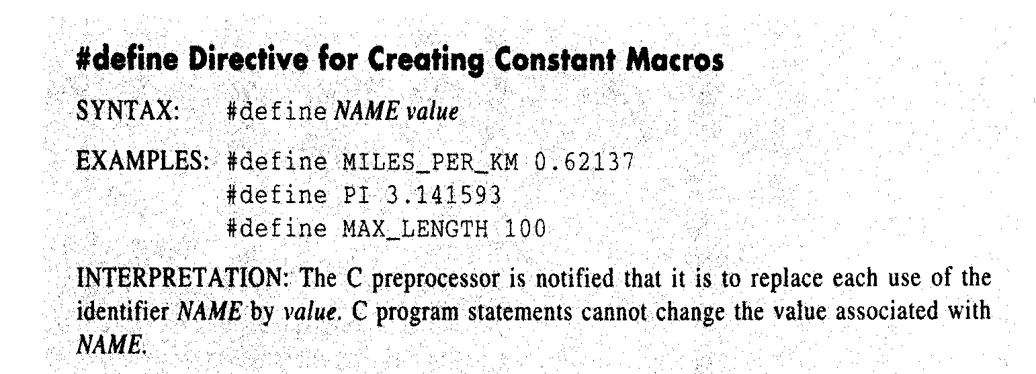

Slide 9
Function main
C programs consist of functions one of which must be main.
Every C program begins executing at the function main.

Slide 10
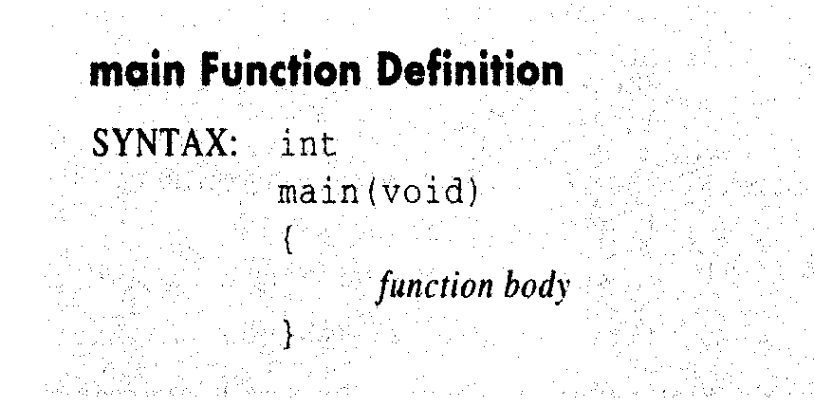
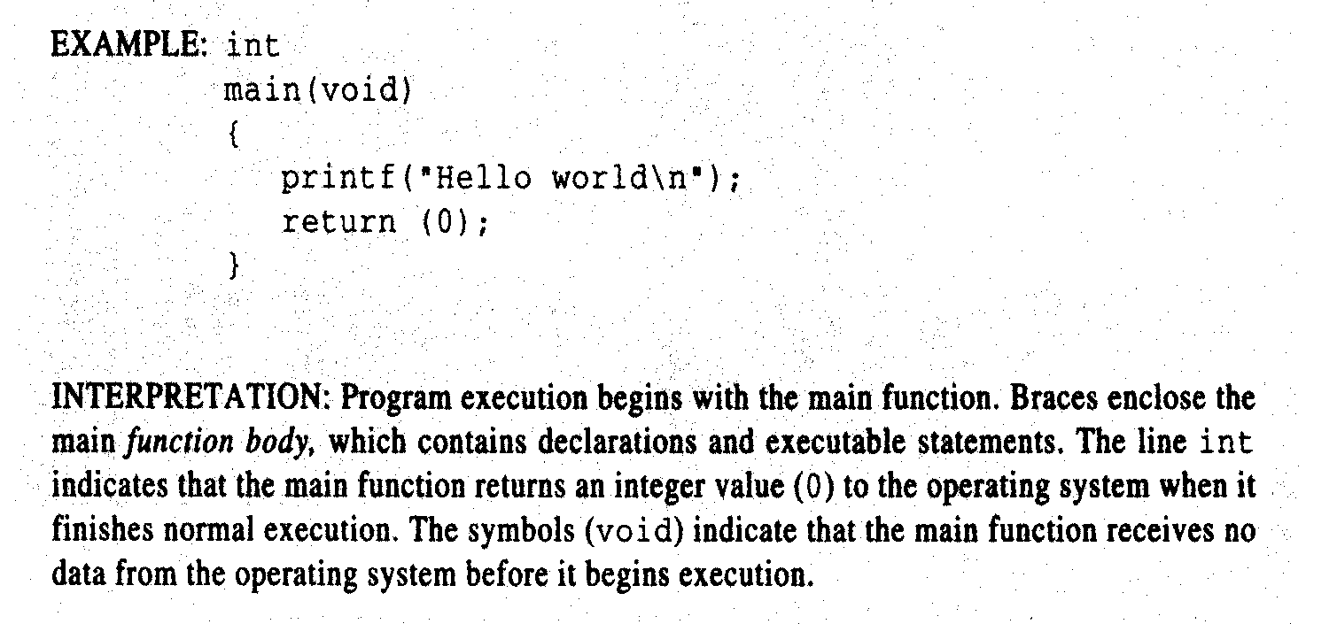

Slide 11
Comments
Statements that clarify the program - ignored by compiler but "read" by humans.
Comments begin with /* and end with */.
Programmers insert comments to document programs and improve their readability.
Comments do not cause the computer to perform any action when the program is run.
/* Get the distance in miles */
double miles; /* distance in miles */

Slide 12
Declaration of variables in the program
Variables are names of memory cells that will store
information - input data and results.
E.g.
double miles;
Declares a variable miles:
- miles is the name or identifier of the variable.
- double is the data type of the variable. (This particular type is for storing a real number. See later!)
Must declare the name and data type of all variables used in the program.

Slide 13
Other example declarations:
int kids, courses;
Declares the variables kids and courses that can store
integer (whole number values).
Note may have more than one variable named in the declaration statement.
char initial;
Declares the variable initial that can store a single
character.

Slide 14
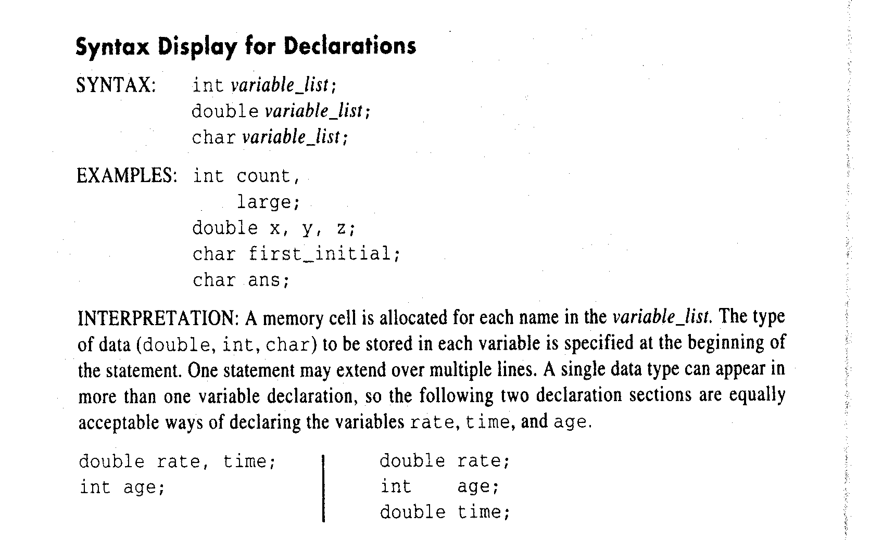

Slide 15
Identifiers
There are three categories of identifiers in C:
- reserved words: a word that has a special
meaning in the C language. E.g. main, void, int, …
Reserved words are just that - they cannot be used for any other purpose. Also called keywords.
- standard identifier: a word that also has a special meaning in C. E.g. printf, scanf, …
However, their use can be re-defined - but it is not
recommended.
- user-defined identifier: a word used by the programmer to name program constants and variables.

Slide 16
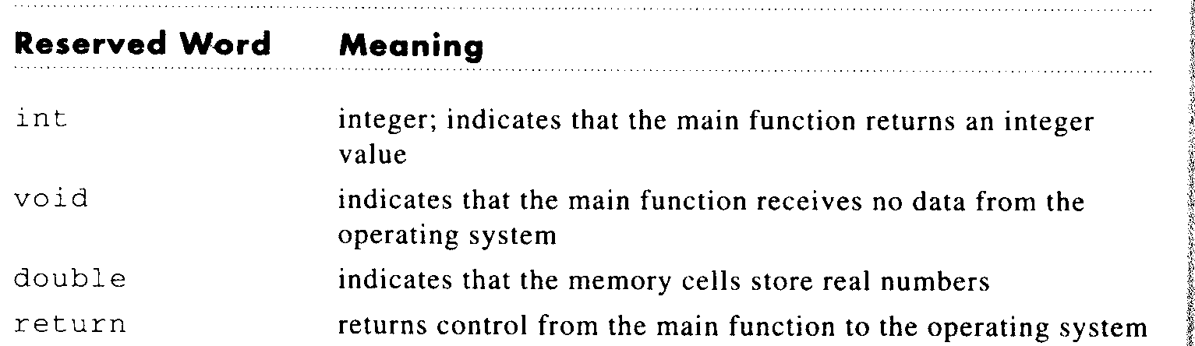

Slide 17
User-defined identifiers
Rules:
- identifier must consist only of letters, digits and
underscores. Must not begin with a digit.
- limit length of identifier to maximum of 31 symbols.
- do not use a C reserved word as an identifier.

Slide 18
The C compiler is case-sensitive, i.e. it differentiates between uppercase and lowercase letters.
Thus, the identifiers
rate
Rate
RATE
are considered to be different identifiers.
Be careful! But adopt a consistent style.
Note: that all C reserved words and names of standard
library functions are in lowercase only.

Slide 19
One common practice is
- to use uppercase for CONSTANTS
- to use lowercase for all other identifiers.

Slide 20
Program Style Hints
A program that “looks good” is easier to read, understand and debug.
1. Always choose meaningful identifier names.
E.g. identifier miles is better than m
2. If identifier consists of two or more words, separate words by an underscore, _.
E.g. KMS_PER_MILE is better than KMSPERMILE
3. Avoid excessively long names - avoid typing errors.
E.g. KMS_PER_MILE is better than KILOMETERS_PER_MILE

Slide 21
4. Do not use names that are similar to each - the compiler does not know that you may have mistyped one name for another.
In particular, avoid names that differ only in the use of
lower case and uppercase, or differ by the presence or absence of an underscore.
E.g. Large and large, x_coord and xcoord

Slide 22
Summary
All variables in a C program must be declared before they can be used in the program.
Every variable stored in the computer's memory has a name, a value and a type.
A variable name in C is any valid identifier. An identifier is a series of characters consisting of letters, digits and underscores ( _ ). Identifiers cannot start with a digit. Identifiers can be any length; however, only the first 31 characters are significant.
C is case sensitive

Slide 23
Variable Declarations and Data Types
A data type specifies a set of values and a set of operations on those values.
The (data) type of every program variable must be specified in the declaration statement.
Types tell the CPU how to interpret the 0s and
1s in the memory cell where any given variable is stored.
Types help the computer and the programmer keep things straight

Slide 24
Basic Data Types
int - integer numbers - whole numbers in the range: -32767 -- 32767
char - single character - character must be enclosed by single quotes within the program.
double - numbers with fractional parts - real numbers.
In program, write with decimal point, e.g. 123.0 or scientific notation, e.g. 1.23e2 or 1.23E2
We will see more types later.

Slide 25
Declaring Variables
int months;
Can hold integer data, like 6, 12, -170000001
double pi;
Can hold floating-point representations of numbers, like 3.14159, 2.71828
char initial;
Can hold a single character, like ‘i’, ‘K’, ‘@’
Note that a declaration is terminated with a semi-colon, ;.

Slide 26
Executable Statements
Executable statements follow the data declarations in a function.
They are the C program statements used to write or code the algorithm.
C complier translates these statements to machine code.
Then the computer executes these when we run the program.

Slide 27
Assignment statements
Most common executable statement is the assignment statement.
Used to assign a value to a variable.
General format:
variable = expression;
The value to be assigned is written on the right hand of the assignment operator =.
The variable getting the value is on the left hand side.
Note that the statement is terminated by a semi-colon, ;
Computer first evaluates
expression to determine
its value

Slide 28
Expression may be a single
variable or constant, or some
combination, e.g. an arithmetic
expression
E.g.
kms = 1.609 * miles;
Variable kms is assigned the value of 1.609*miles
( * means multiply in C). The current value of kms is overwritten by the new value.
Note: the variable miles must be given a value before the assignment statement. This is true for any assignment statement involving variables.

Slide 29
The = sign is rather odd.
In maths, the = means two things are equal
In C, the = sign means “takes the value of”.
It is the assignment operator:
x = y; means “x takes the value of y”
Or, “x is assigned the value of y”

Slide 30
sum = x + y;
sum takes the value of x + y.
kids = kids + 1;
kids gets the value of the "current value of kids" + 1. If
kids was 5, its new value will be 6 (strange, but true!)
hypotenuse = sqrt(side1 * side1 +
side2 * side2);
(sqrt is a C function for calculating square roots.)
Assignment statements can be quite complex!

Slide 31
Notice that
x + y = sum;
is invalid. Why?

Slide 32
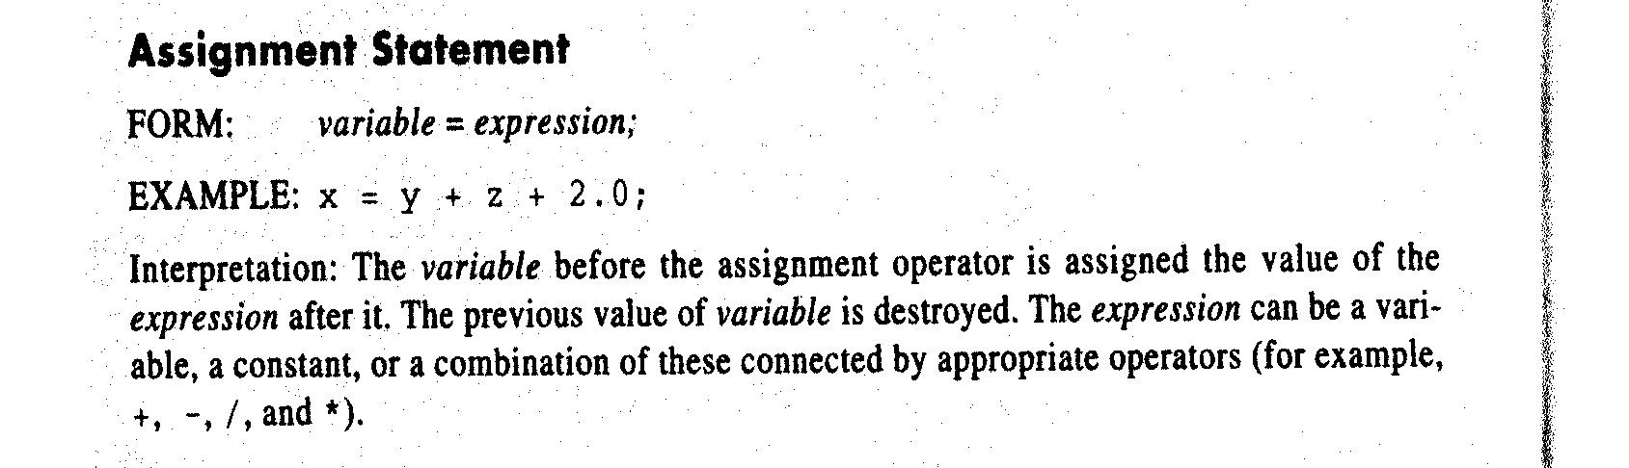

Slide 33
Initializing Variables
Initialization means giving something a value for the first time.
Any way which changes the value of a variable is a potential way of initializing it:
– assign an initial value in a declaration:
E.g.
int i = 7;
– assign a value by an assignment statement:
E.g.
count = 0;
- assign a value by reading
E.g.
scanf("%lf", &miles);

Slide 34
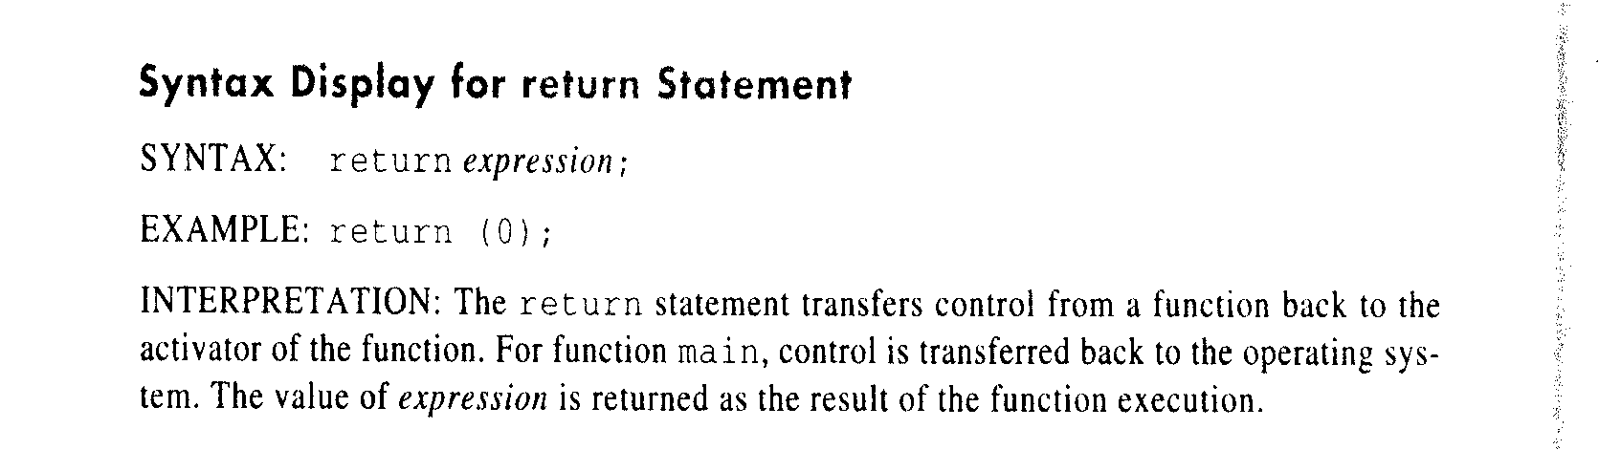

Slide 35
Summary
An assignment statement puts a value into a variable
The assignment may specify a simple value, or an expression
Remember = means “takes the value of”
The computer always evaluates what is on the right of the = and stores it in the variable on the left

Slide 36
Review Quiz
Find the assignments, declarations, and initializations:
int main (void) {
double income; /* ??? */
income = 35500.00; /* ??? */
printf(“Old income is %f”, income);
income = 39000.00; /* ??? */
printf(“After raise: %f”, income);
}

Slide 37
Arithmetic expressions
To solve most programming problems, need to write
arithmetic expressions that manipulate numeric type
data.
Expressions may be combinations of numeric constants (E.g. 105), program constants (E.g. KMS_PER_MILE ) and/or program variables (E.g. miles), together with
arithmetic operators
Arithmetic operators are
+, -, *, /

Slide 38
Arithmetic operators
+ Addition 5+9=14
- Subtraction 5.2 - 3.1 = 2.1
* Multiplication 5.2 * 2 = 10.4
/ Division 5.0 / 2.0 = 2.5
5 / 2 = 2
% Remainder 7 % 6 = 1
Relationship between the operators / and % for an integer dividend of m and integer divisor of n:
m equals (m/n)*n + (m%n)
Example:
11 equals (11/2)*2 + (11%2)
equals 5 *2 + 1

Slide 39
Data type of an Expression
Data type of each variable must be specified in its declaration.
Data type of an expression depends on the type of its operands.
var1 arithmetic_operator var2
is of type int if both var1 and var2 are of type int; otherwise, it is of type double

Slide 40
Mixed-Type Assignment Statement
An expression that has operands of both type int and double is a mixed-type expression
  a = b + c * ( b – d )
  Double = int and /or double
  int = int and/or double but only the integral part is saved into a
The expression is first evaluated; then the results is assigned to the variable listed to the left of the assignment operator (=).

Slide 41
Rules for evaluating multiple operators
  Parenthesis rule
  Operator precedence rule
    Unary + -
    *, /, %
    Binary +, -
  Associativity rule
    Unary operators at the same precedence level – right to left evaluation (right associativity)
    Binary operators at the same precedence level – left to right evaluation (left associativity)
    Z-(a+b+b/2)+w*-y
    In complicated expressions use extra parentheses

Slide 42
Writing mathematical formulas
Always specify multiplication explicitly by using the operator * where needed
Use parenthesis when required to control the order of operator evaluation
Two arithmetic operators can be written in succession if the second is a unary operator

Slide 43
I/O Operations and Library Functions
Need to get data into program from keyboard and display
information (including results) on screen.
The library functions scanf and printf do this for us.
- printf is used for output to the screen
- scanf is used for input from the keyboard
E.g.
printf("Enter distance in miles> ");
- write some text
scanf("%lf", &miles);
- read a value for variable miles
printf("That equals %f kms.\n", kms);
- write some text and value of miles

Slide 44
Each call to printf and scanf begins with a format string in double quotes “…”.
I.e.
printf(format string);
printf(format string, print list);
scanf(format string, input list);
The format string specifies the format for the input or output.

Slide 45
After the format string comes
- an input list (for scanf)
- a print list (for printf). Optional.
The variables named in the input list must be preceded by an ‘&’ (e.g. &miles).

Slide 46
The format strings contain multiple placeholders, one for each variable in the list.
Placeholders indicate the data type and position of a variable in a format string.
Use:
%lf in scanf for type double value
%f in printf for type double value
%d in printf and scanf for type int value
%c in printf and scanf for type char value

Slide 47
E.g.
Format string
printf("That equals %f kms.\n", kms);
Placeholder Variable
When this statement is executed, the current value of kms is printed at the place indicated by the placeholder in the format string.
kms is a double data type, so placeholder is %f
If kms has the value 25, say, then the what is printed is
That equals 25 kms

Slide 48
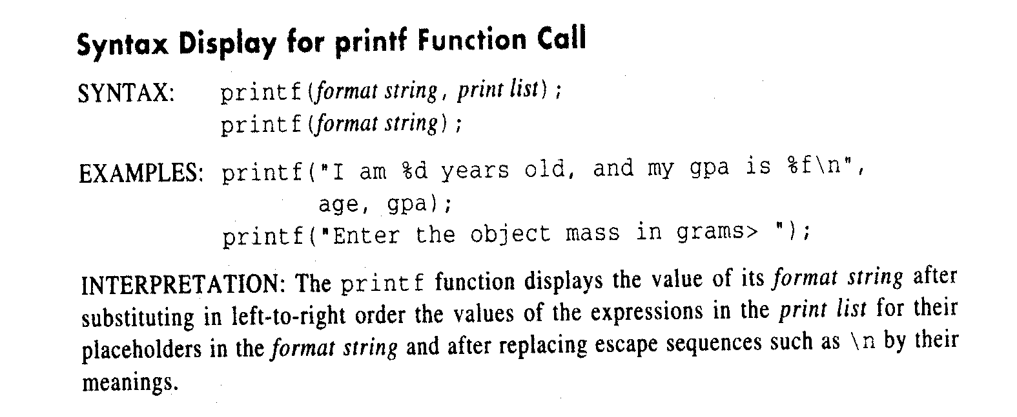

Slide 49
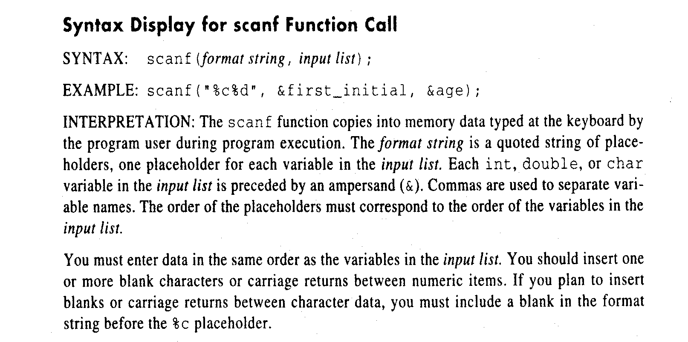

Slide 50
Examples
1. Display a prompt(ing) message that tells program user what to enter.
E.g.
printf("Enter distance in miles> ");
scanf("%lf", &miles);
What the user sees is
Enter distance in miles>
The program user then can type in the data value requested which is processed by the scanf function.

Slide 51
2. Displaying blank lines
The two-character sequence, \n, produces "newline" on output - equivalent to typing Enter.
E.g.
printf(“\n”);
E.g.
printf("That equals %f kms.\n", kms);
Prints a newline after the message

Slide 52
3. Printing two or more variables
printf might have more than one expression in its list.
E.g.
int multiplier = 2;
double number, double_number;
number = 3.14;
double_number = multiplier * number;
printf(" %d times %f is %f. \n",
multiplier , number , double_number );
Output: 2 times 3.14000 is 6.28000

Slide 53
Basic rule: placeholders in format string must match
expressions in output list in number, order, and
type.

Slide 54
4. Inputting a value into a variable
scanf("%lf", &miles);
Placeholder Note! Variable
The real number value typed at the keyboard is assigned to the variable, miles.

Slide 55
5. Reading two or more data items with scanf
E.g.
printf(“Enter hours and rate>”);
scanf(“%lf%lf”, &hours, &rate);
First number stored in hours, second in rate. Should be at least one space between numbers. Don’t forget &s!
E.g
char first, second;
printf(“Enter your two initials>”);
scanf(“%c%c”, &first, &second);

Slide 56
Basic rule: placeholders in the format must match
variables in the input list.
Must match one-for-one in number, order,
and type.
int studentID ;
double grade ;
scanf ("%d %lf", &studentID , &grade ) ;
Be aware that advanced formatting options exist
and can be looked up when needed.

Slide 57
Formatting Numbers in Program Output
Field width – the number of columns used to display a value
Formatting values of type int
Placeholder format is: %nd, right justified
E.g.
printf (“Results: %3d meters = %4d ft. %2d in.\n”,meters, feet, inches);
Results:
▄ ▄ 21 ▄ meters ▄ = ▄ ▄ ▄ 68 ▄ ft. ▄ 11 ▄ in.
(▄ - represents blank character)

Slide 58
Formatting Values of type double
Placeholder format is: %n.m
n – total field width (incl. decimal point and minus sign)
m – desired number of decimal places
See Table 2.11 and 2.12, Section 2.6

Slide 59
Batch Version of Miles-to-Kilometers Conversion Program (page 77)
/* Converts distances from miles to kilometers. */
#include <stdio.h> /* printf, scanf definitions */
#define KMS_PER_MILE 1.609 /* conversion constant */
int main(void)
{
double miles, /* distance in miles */
kms; /* equivalent distance in kilometers */
/* Get and echo the distance in miles. */
scanf("%lf", &miles);
printf("The distance in miles is %.2f.\n", miles);
/* Convert the distance to kilometers. */
kms = KMS_PER_MILE * miles;
/* Display the distance in kilometers. */
printf("That equals %.2f kilometers.\n", kms);
return (0);
}
The command line for running this program (metric) is:
metric < mydata
The file mydata contains input data (112.00)
Redirection of the input
Output
The distance in miles is 112.00.
That equals 180.21 kilometers.

Slide 60
Input and Output controlled by the program
Declare a file pointer variable of type FILE
  FILE *inp, *outp;
The OS prepares a file for input and/or output
  inp = fopen (“File1”, “r”);
    outp = fopen (“File2”, “w”);
  fscanf (inp, “……);
  fprintf (outp, “…….);
Close the files
  fclose (inp);
  fclose (outp);

Slide 61
Miles-to-Kilometers Conversion Program with Named Files
#include <stdio.h> /* printf, scanf, fprint, fscanf, fopen, fclose definitions */
#define KMS_PER_MILE 1.609 /* conversion constant */
int main(void)
{
double miles, /* distance in miles */
kms; /* equivalent distance in kilometers */
FILE *inp, /* pointer to input file */
*outp; /* pointer to output file */
/* Open the input and output files. */
inp = fopen("b:distance.dat", "r");
outp = fopen("b:distance.out", "w");
/* Get and echo the distance in miles. */
fscanf(inp, "%lf", &miles);
fprintf(outp, "The distance in miles is %.2f.\n", miles);
/* Convert the distance to kilometers. */
kms = KMS_PER_MILE * miles;
/* Display the distance in kilometers. */
fprintf(outp, "That equals %.2f kilometers.\n", kms);
/* Close files. */
fclose(inp);
fclose(outp);
return (0);
}
Contents of input file distance.dat
112.0
Contents of output file distance.out
The distance in miles is 112.00.
That equals 180.21 kilometers.

Slide 62
Common Programming errors
Syntax Errors
  Caused by violation of grammar rules of C
Run-Time Errors
  Displayed during execution
    Division by 0
Undetected errors
  Usually lead to incorrect results
Logical errors
  Caused by following an incorrect algorithm
  Difficult to detect

Slide 63
Compiler Listing of a Program with Syntax Errors
221 /* Converts distances from miles to kilometers. */
222
223 #include <stdio.h>
266 #define KMS_PER_MILE 1.609
267
268 int
269 main(void)
270 {
271 double kms
272
273 /* Get the distance in miles. */
274 printf ("Enter the distance in miles> ");
***** Semicolon added at the end of the previous source line
275 scanf ("%lf", &miles);
***** Identifier "miles" is not declared within this scope
***** Invalid operand of address-of operator
276
277 /* Convert the distance to kilometers. */
278 kms = KMS_PER_MILE * miles;
***** Identifier "miles" is not declared within this scope
279
280 /* Display the distance in kilometers. * /
281 printf ("That equals %f kilometers.\n", kms);
282
283 return (0);
284 }
***** Unexpected end-of-file encountered in a comment
***** "}" inserted before end-of-file

Slide 64
A Program with a Run-time Error
111 #include <stdio.h>
262
263 int main (void)
264 {
266 int first, second;
267 double temp, ans;
268
269 printf ("Enter two integers> ");
270 scanf ("%d%d", &first, &second);
271 temp = second / first; /* temp = 3/14 = 0 */
272 ans = first / temp;
273 printf ("The result is %.3f\n", ans);
274
275 return (0);
276 }
Enter two integers> 14 3
Arithmetic fault, divide by zero at line 272 of routine main

Slide 65
A Program That Produces Incorrect Results Due to & Omission
#include <stdio.h>
int main(void)
{
int first, second, sum;
printf ("Enter two integers> ");
scanf ("%d%d", first, second); /* ERROR! Should be &first, &second */
sum = first + second;
printf ("%d + %d = %d\n", first, second, sum);
return (0);
}
Enter two integers> 14 3
5971289 + 5971297 = 11942586

Slide 66
Summary
Every C program has preprocessor directives and a main function
Variable names must begin with a letter and consist of letters, digits and underscore symbol. A reserved word cannot be used as an identifier
The data type of each variable must be declared. Three standard data types are int, double and char.
Assignment statements are used to perform computations and store results in memory.
Function calls are used to get data (functions scanf and fscanf) and to display values stored in memory (functions printf and fprintf)

